Slide 1

Resilient Applications in Azure
K. Scott Allen
@OdeToCode
Notes:
Needs:
API Manager pointing to a few APIs with Swagger docs
Service Fabric application
Traffic Manager
Service Bus

Slide 2

High Availability
Disaster Recovery
Notes:
Needs images, ideally have some animation, too

Slide 3


Slide 4









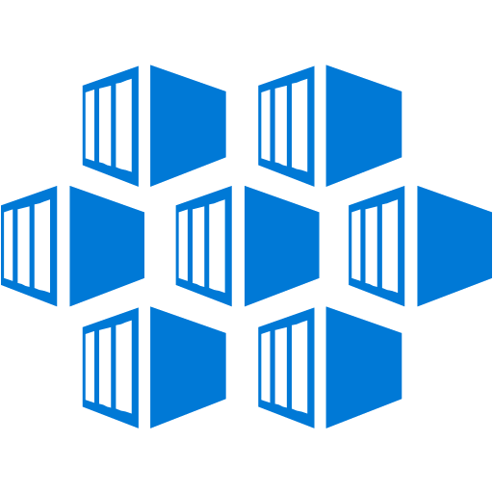






























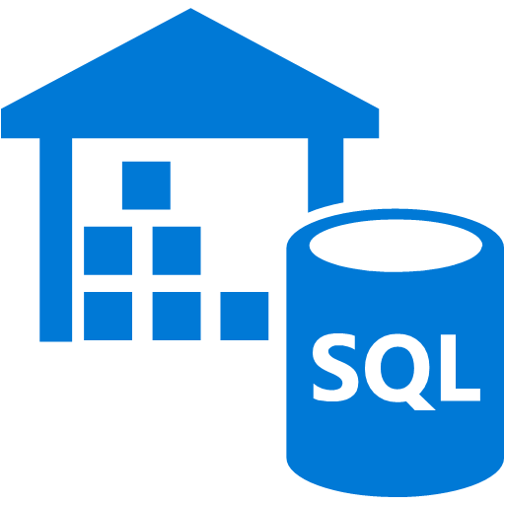






Infrastructure
Services
Platform Services
Security & Management
Compute
App Service
Analytics & loT
Compute
Cloud
Services
Windows
Web Apps
HDInsight
Portal
Service Fabric
Active
Directory
Linux
API Apps
Machine Learning
Containers
Batch
API
Management
Data Factory
Multi-Factor Authentication
Storage
Integration
Event Hubs
Automation
Mobile Apps
BLOB Storage
Storage
Queues
Key Vault
Logic Apps
Stream Analytics
Azure Files
Biztalk
Services
Notification
Hubs
Mobile
Engagement
Store/Marketplace
Premium Storage
Hybrid
Connections
VM Image Gallery
& VM Depot
Networking
Data
Virtual Network
Service Bus
Developer Services
SQL Database
Load Balancer
Media & CDN
Visual Studio
Redis Cache
DNS
Media Services
Azure SDK
DocumentDB
Express Route
Content Delivery
Network (CDN)
SQL Data
Warehouse
Team Project
Traffic Manager
Application
Insights
Search
VPN Gateway
Application Gateway
Tables

Slide 5
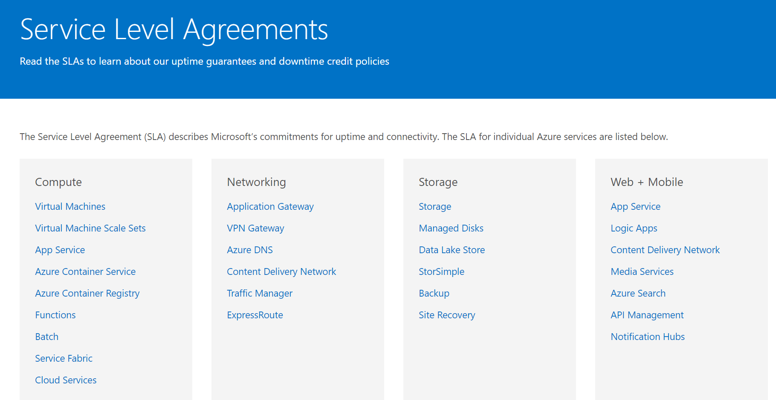

Slide 6
SLA | Downtime/week | Downtime/month | Downtime/year
99% | 1.68 hours | 7.2 hours | 3.65 days
99.9% | 10.1 minutes | 43.2 minutes | 8.76 hours
99.95% | 5 minutes | 21.6 minutes | 4.38 hours
99.99% | 1.01 minutes | 4.32 minutes | 52.56 minutes
99.999% | 6 seconds | 25.9 seconds | 5.26 minutes

Slide 7
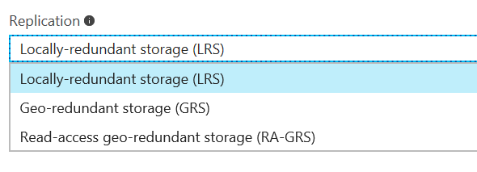

When Disaster Strikes
Blob Storage
Redundant Storage

Slide 8
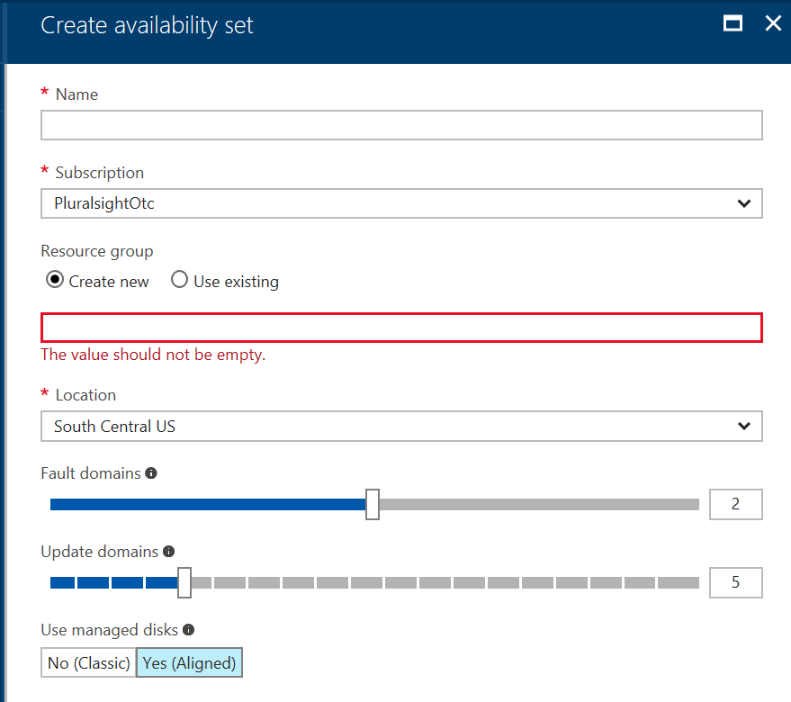

When Disaster Strikes
Blob Storage
Redundant Storage
Virtual Machines
Availability Sets

Slide 9
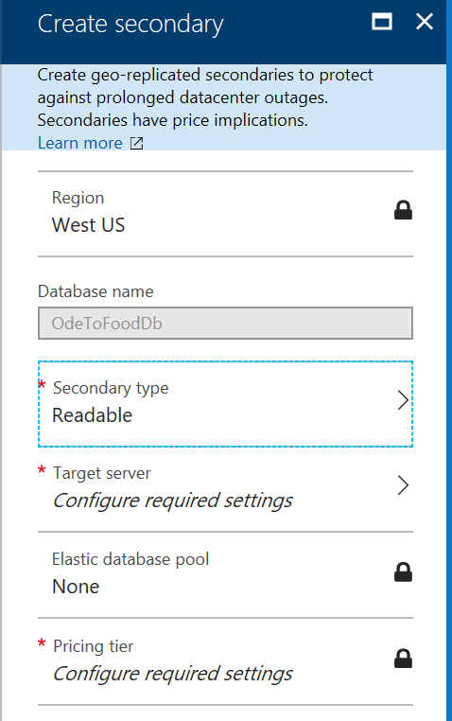
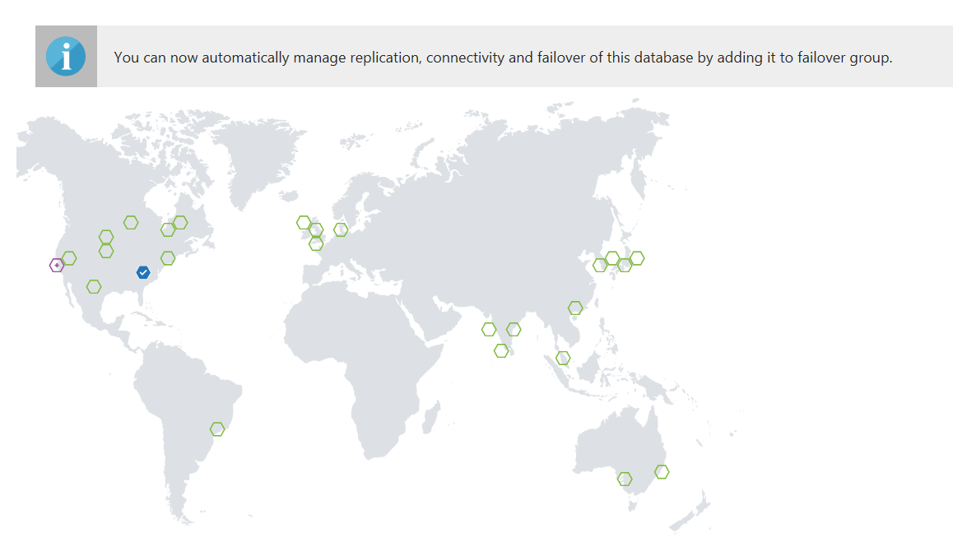

When Disaster Strikes
Blob Storage
Redundant Storage
Virtual Machines
Availability Sets
SQL
Replication
Point in Time Restore

Slide 10

When Disaster Strikes
Blob Storage
Redundant Storage
Virtual Machines
Availability Sets
SQL
Replication
Point in Time Restore
App Services
Geo Distributed

Slide 11



App Service
Resource
Group
Blob Storage
Customers
Azure SQL
Deployment Slots
Staging
Production
QA
App Service Plan

Slide 12

Connection Resiliency

Slide 13
Retry Logic
Service | Retry Logic
Azure Storage | In SDK
Azure SQL | In Entity Framework
Service Bus | In SDK
CosmosDB | In SDK
Azure Redis Cache | In SDK

Slide 14
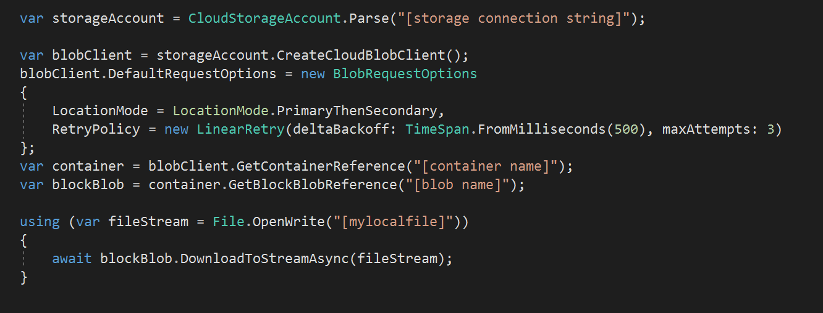
Retry Logic
Service | Retry Logic
Azure Storage | In SDK
Azure SQL | In Entity Framework
Service Bus | In SDK
DocumentDB | In SDK
Azure Redis Cache | In SDK

Slide 15
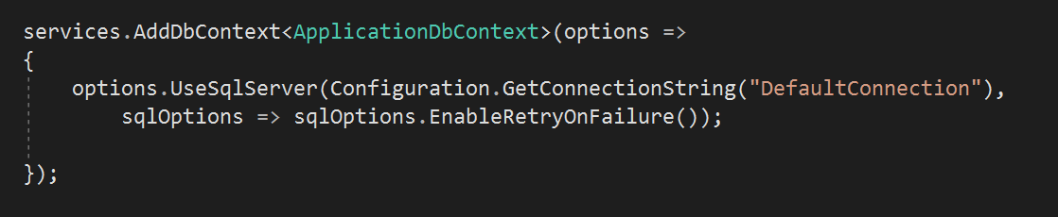
Retry Logic
Service | Retry Logic
Azure Storage | In SDK
Azure SQL | In Entity Framework
Service Bus | In SDK
DocumentDB | In SDK
Azure Redis Cache | In SDK

Slide 16


Graceful Degradation

Slide 17


App Service
Functions
WebJobs
Redis
Key Vault
Customers
Storage Account
DocumentDB
App
Insights
Blob
Queue
Table
Azure
Active
Directory
Azure SQL
Search
CDN

Slide 18
Traffic
Manager
App Service
Queue
DocumentDB
Azure SQL
Customers
Geo replication
App Service
Queue
DocumentDB
Azure SQL

Slide 19
Load Balancing
Azure Load Balancer
Azure Application Gateway
Azure Traffic Manager

Slide 20


Slide 21
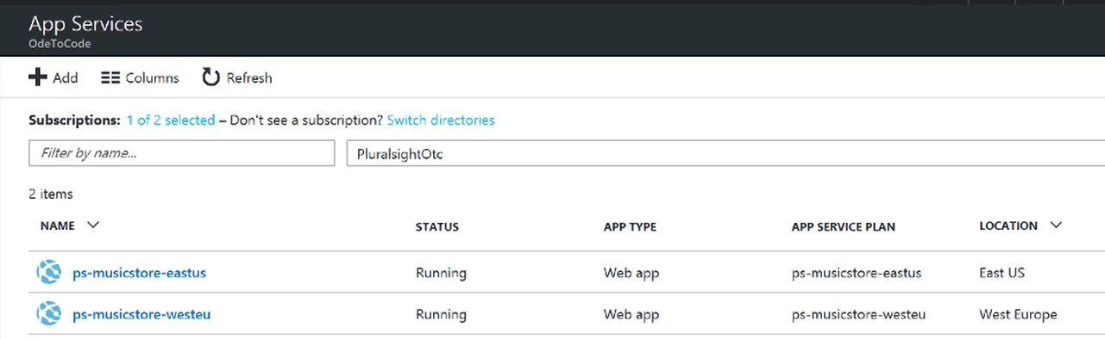

Slide 22
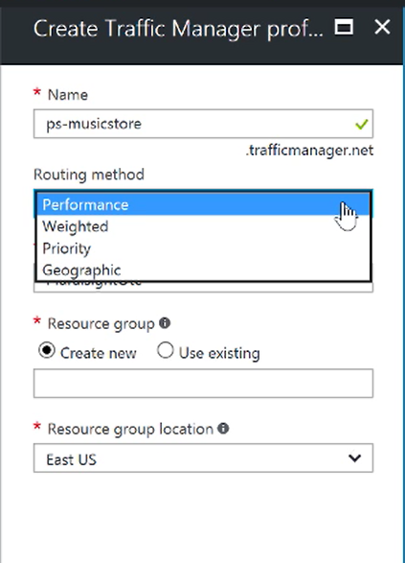

Slide 23
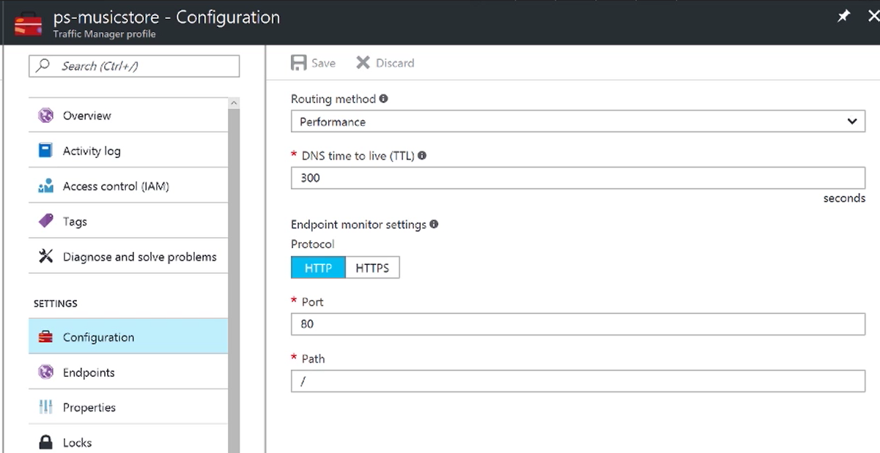

Slide 24
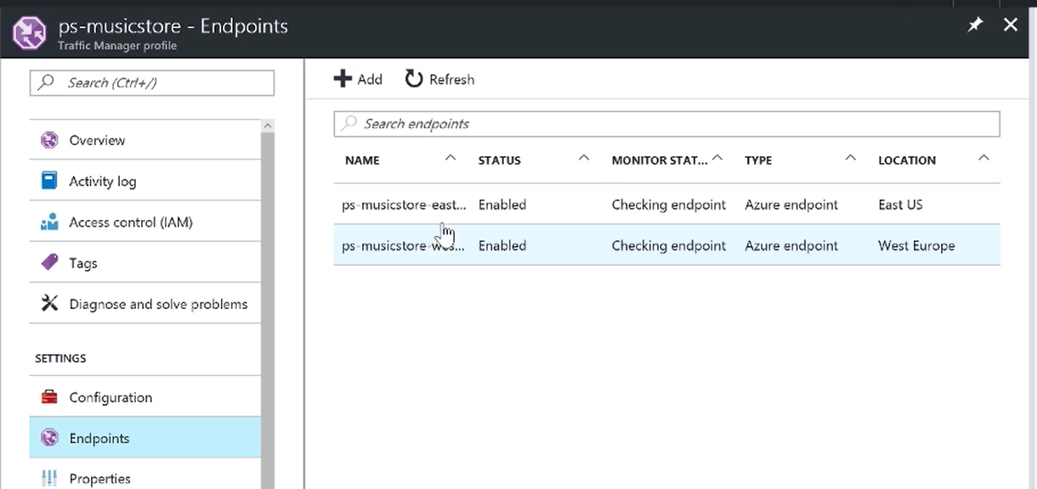

Slide 25



Load Leveling

Slide 26



Service Bus
Topics | Relays | Queues

Slide 27
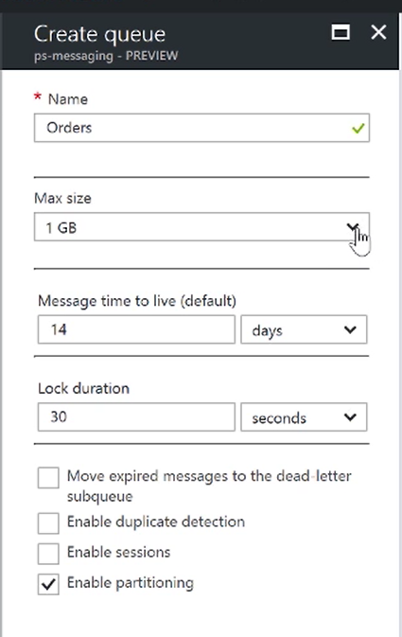
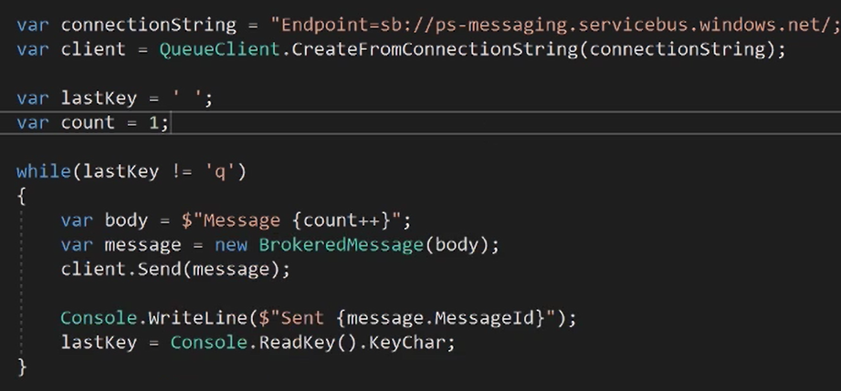

Slide 28







Load Throttling
App Service
Customers
API Manager
VM Hosted Service
Functions
Identity Sources

Slide 29
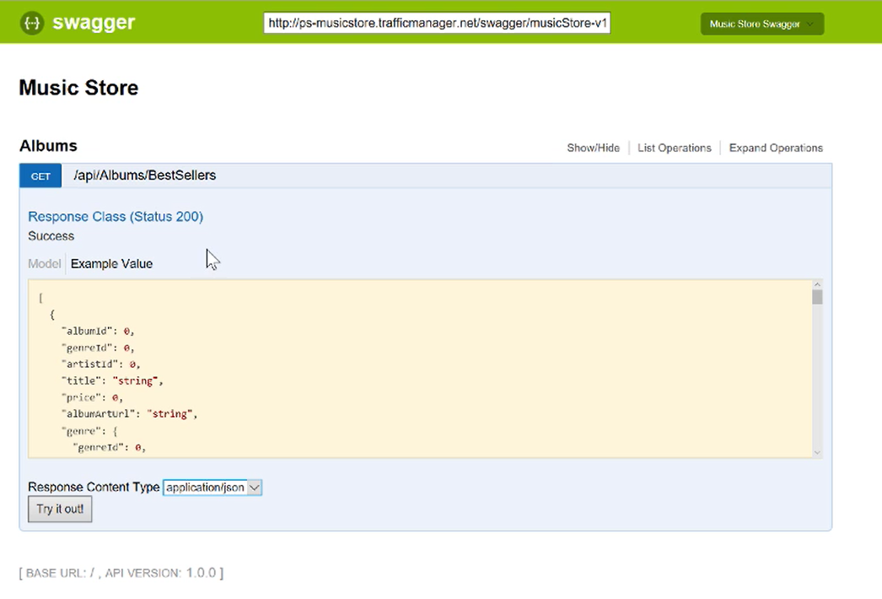

Slide 30
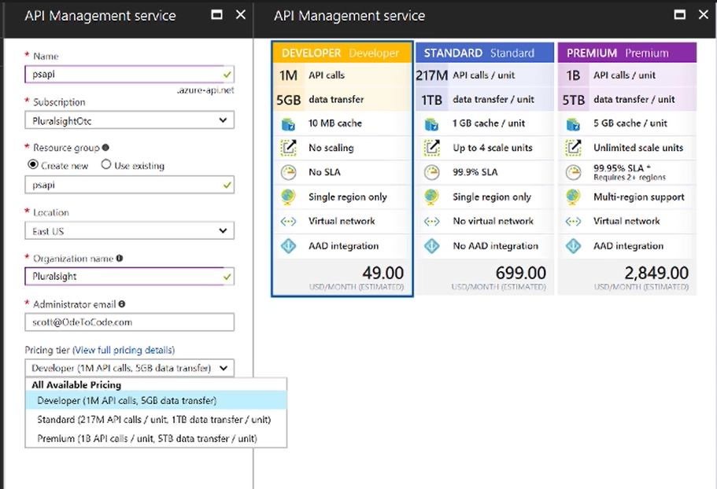

Slide 31
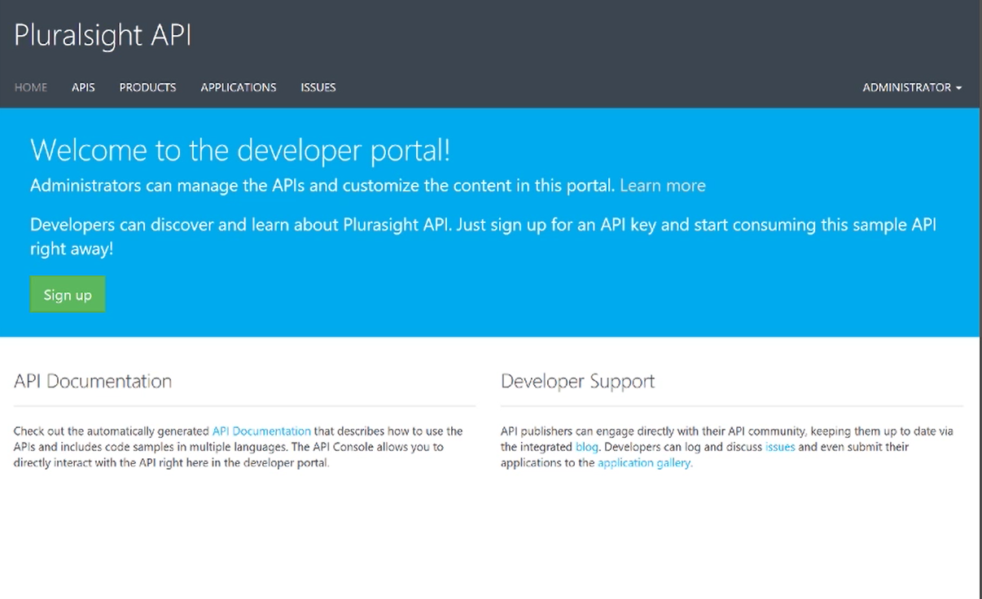

Slide 32
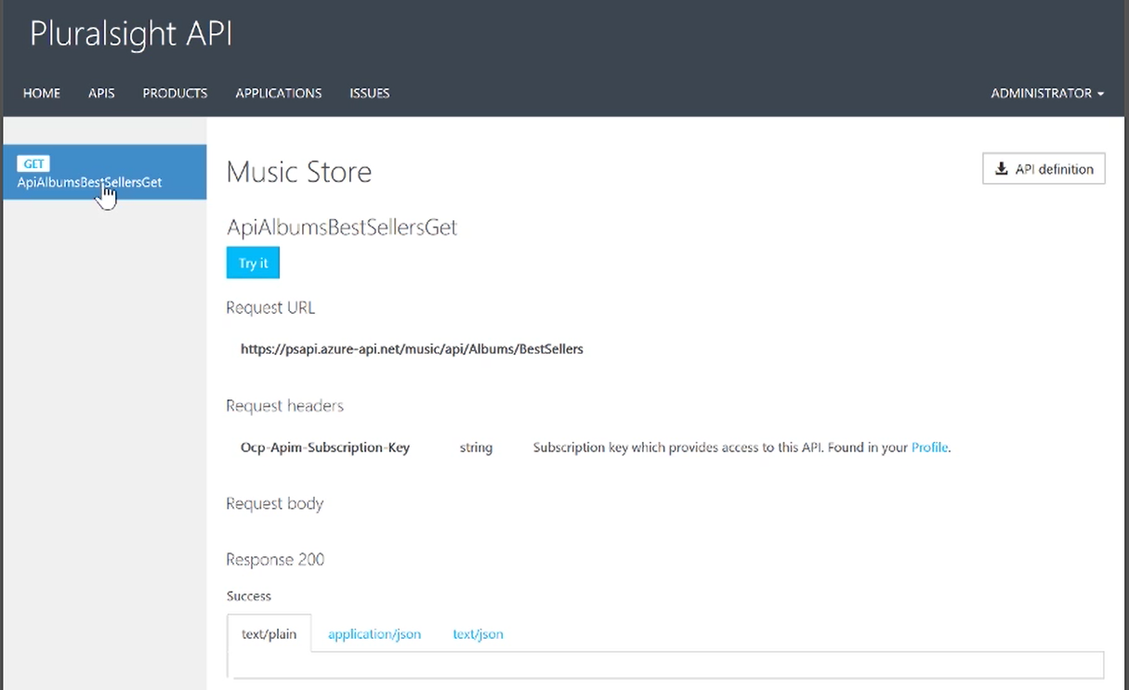

Slide 33
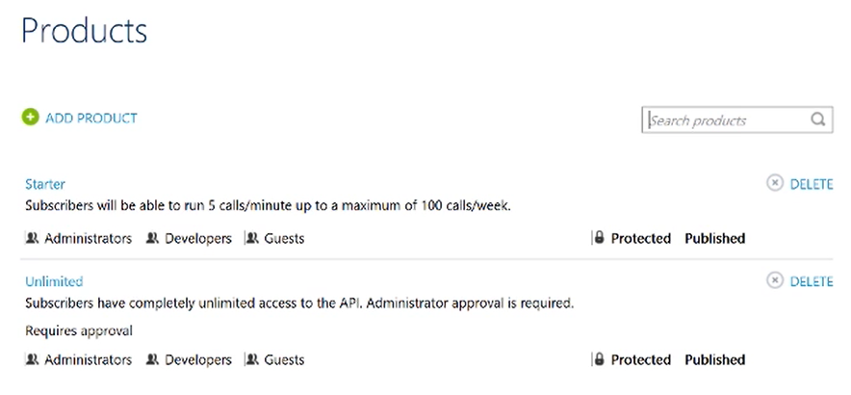

Slide 34
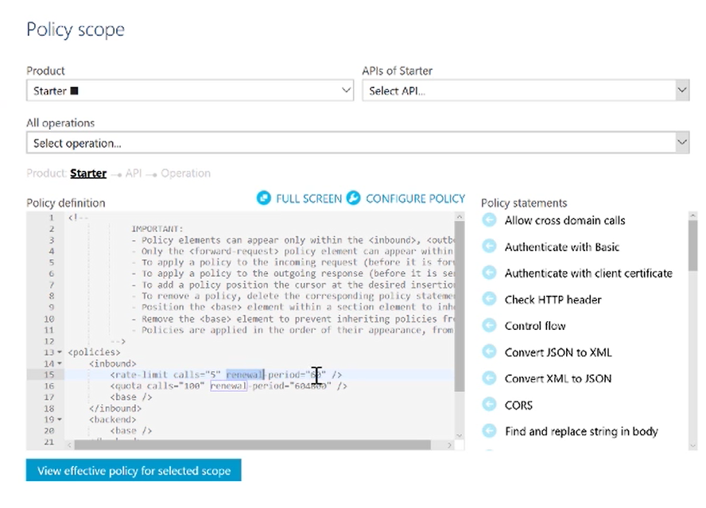

Slide 35
Movie
Store
Identity
Payment
Web UI
Shipping
Inventory
Pricing

Slide 36


A
B
C
A
B
A
C
D
C
A
A
D
C

Slide 37




Service Fabric Programming Models
Reliable Services
Guest Executable
Stateless
Service
Stateful
Service
Stateful
Actor

Slide 38
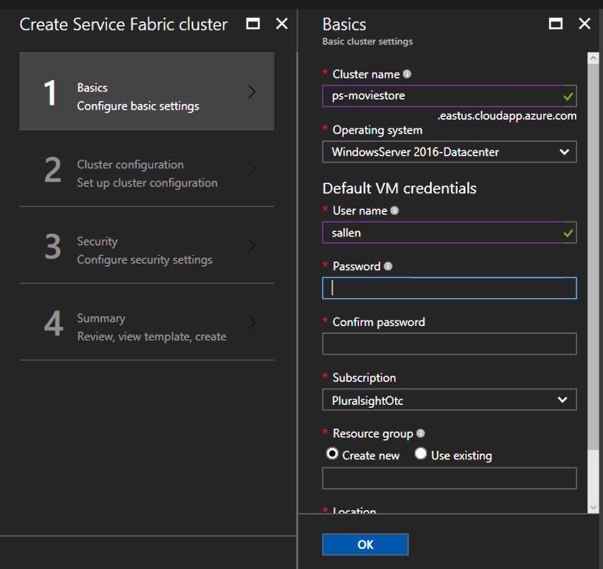

Slide 39
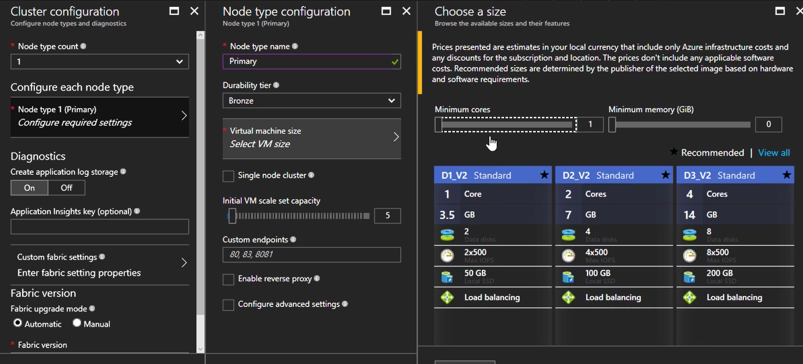

Slide 40

Automation & Deployment

Slide 41


Testing

Slide 42

Monitoring

Slide 43


Slide 44
The End
K. Scott Allen
scott@OdeToCode.com
@OdeToCode

